Slide 1




DataBase Management System
2025
Walmart Retail Data Analytics:
End-to-End Framework
Presented by
Prasad Paymode 124A9038
Arvind Mudaliar 124A9027
Soham Lone 124A9024
Page 1
Next Slide
Sakshi Sukre 124A9054

Slide 2



Introduction
This project addresses critical challenges in modern retail by transforming massive sales data into actionable intelligence. Walmart generates vast transactional information, but organizations often lack analytical capabilities to leverage it effectively.
With intense competition shrinking profit margins, data-driven decisions become essential for survival. This end-to-end solution bridges the skills gap by demonstrating integrated data processing with Python, SQL, and multi-database management.
It delivers immediate business value through inventory optimization, customer segmentation, and temporal analysis for staffing and promotions. The framework establishes a scalable foundation for advanced analytics while ensuring reproducible, documented workflows. By converting raw data into strategic insights, it enables retailers to optimize operations, enhance profitability, and maintain competitive advantage in today's data-driven marketplace.
Page 2
Next Slide

Slide 3

PROBLEM
Brief Overview
STATEMENT
This project tackles retailers' core challenge of transforming raw transactional data into actionable intelligence. It systematically addresses data quality issues from multiple sources, bridges analytical capability gaps beyond basic reporting, and breaks down organizational silos preventing holistic analysis.
Purpose of The Presentation
The scope is carefully defined to ensure practical implementation. It focuses specifically on sales data analysis using Python and SQL across MySQL and PostgreSQL databases. The project covers descriptive and diagnostic analytics—including revenue trends, customer segmentation, and product performance—while explicitly excluding predictive modeling and real-time processing.
This targeted approach delivers immediate value through sales monitoring, inventory optimization, and operational planning, while establishing a scalable foundation for future advanced analytics expansions. The framework ensures reproducible, documented workflows that empower data-driven decision-making across the organization.
Page 3
Next Slide

Slide 4
Objectives
Strategies
Integrated Data Pipeline:
Comprehensive Business Intelligence:
Builds a system to transform raw Walmart sales data into structured, analysis-ready datasets using Python and SQL across MySQL and PostgreSQL for flexible, consistent analysis.
Enables detailed insights into revenue trends, product performance, customer segmentation, and operational efficiency for informed decision-making.
Reproducible and Scalable Design:
Accuracy and Practical Value:
Ensures rigorous validation at every stage to maintain reliability while delivering actionable insights for inventory, marketing, and staffing optimization.
Features modular architecture, clear documentation, and reproducible workflows supporting future enhancements like predictive modeling and larger data handling.
Page 4
Next Slide

Slide 5
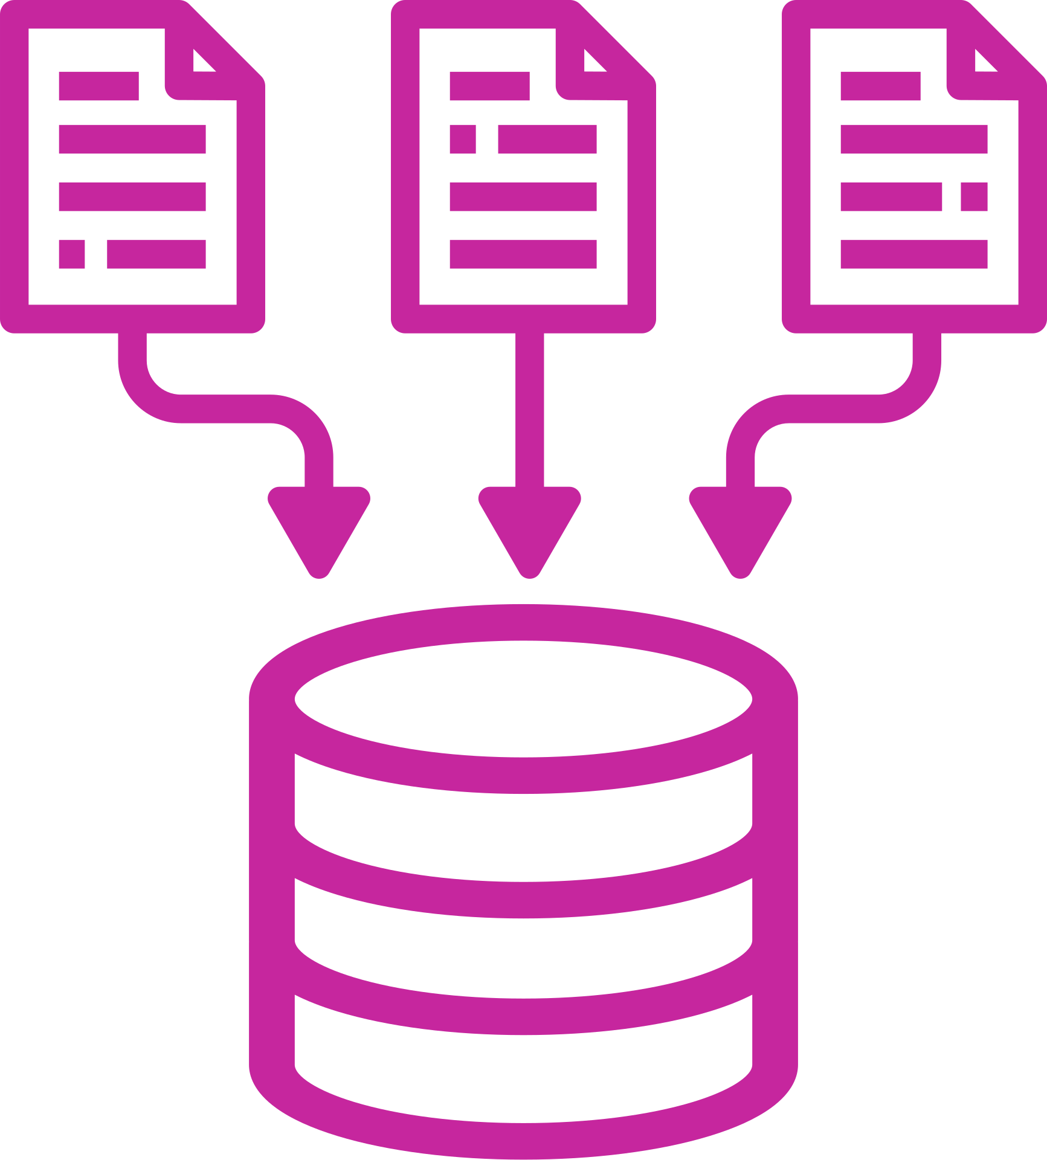
System Architecture and Design
The pipeline begins with robust data acquisition from Kaggle, featuring automated APIs and manual fallbacks.
Data then flows into a multi-stage Python processing engine for cleaning, validation, and feature engineering.
A key innovation is the database abstraction layer, enabling simultaneous operation on both MySQL and PostgreSQL via SQLAlchemy. This ensures analytical consistency and prevents vendor lock-in.
The system utilizes a star-like schema for optimal query performance and houses optimized SQL modules for business intelligence across revenue, customer, and operational themes.
This project employs a layered architecture with five distinct tiers:
Data acquisition
Processing
Storage
Analytical computation
Presentation.
Configuration is externally managed for flexibility, while comprehensive validation and logging ensure reliability. The design is inherently extensible, with interfaces prepared for machine learning, real-time processing, and additional data source integration, ensuring the architecture can evolve with future business needs.
Page 5
Next Slide

Slide 6

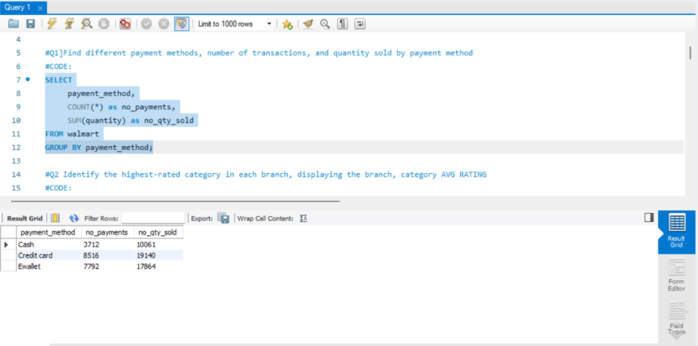
Implementation
Find different payment method and number of transactions, number of qty sold
Page 6
Next Slide

Slide 7
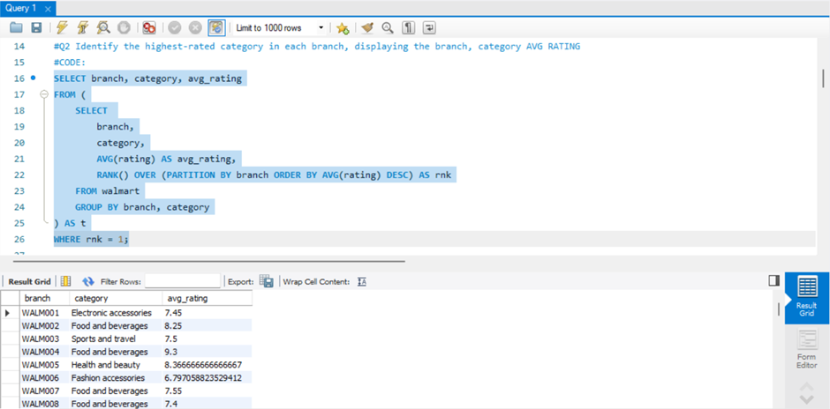
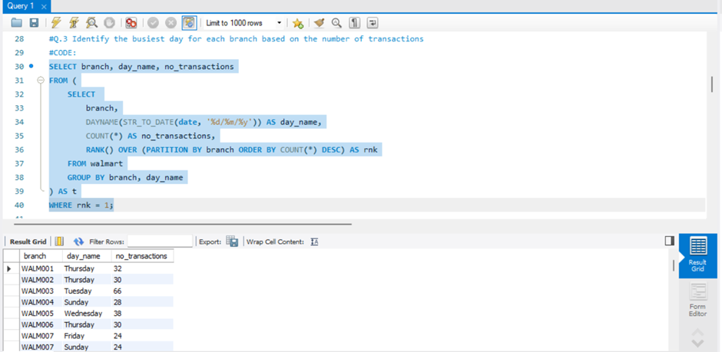

2. Identify the highest-rated category in each branch,
displaying the branch, category and AVG RATING
3. Identify the busiest day for each branch based on the
number of transactions
Page 7
Next Slide

Slide 8
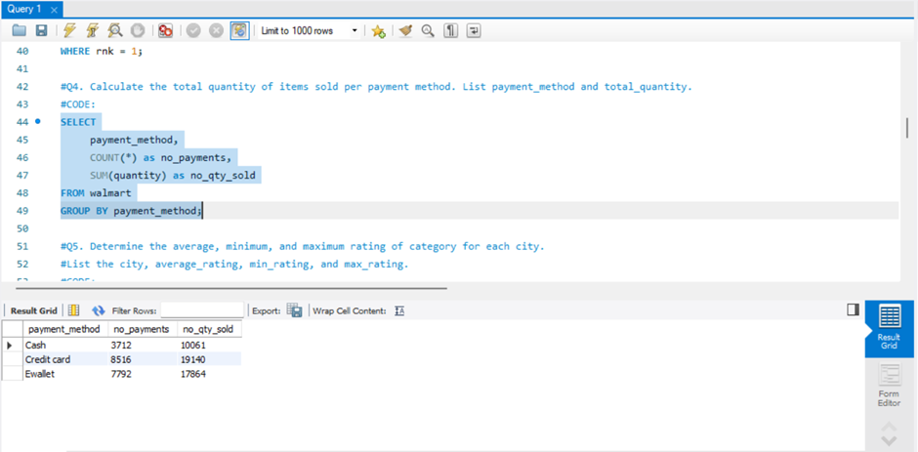
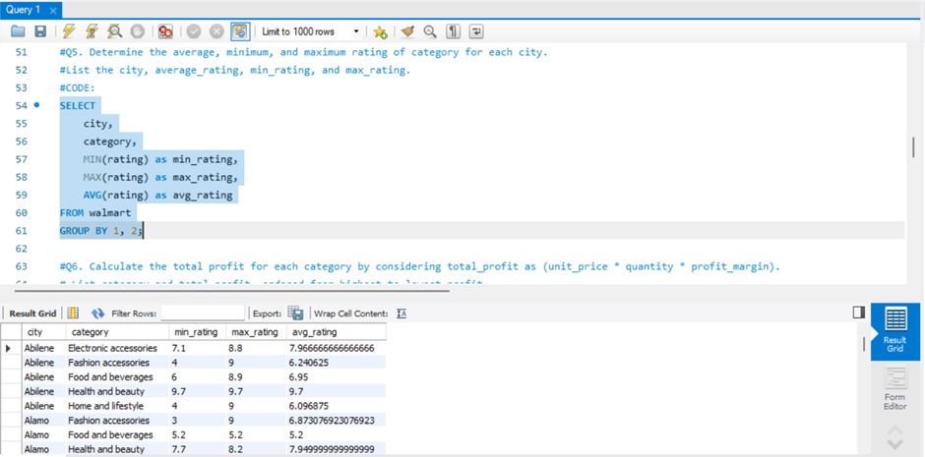
4. Calculate the total quantity of items sold per payment
method. List payment_method and total_quantity.
5. Determine the average, minimum, and maximum rating
of category for each city.
List the city, average_rating, min_rating, and
max_rating.
Page 8
Next Slide

Slide 9
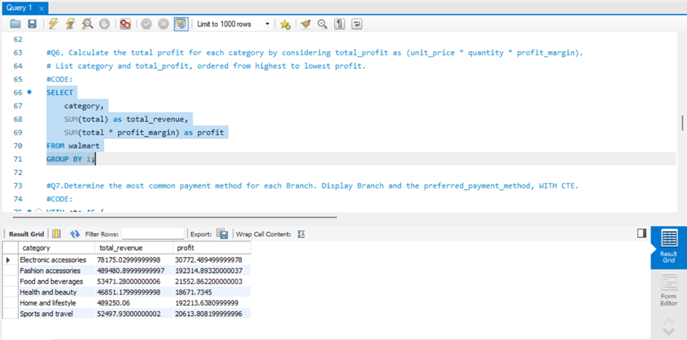

6. Calculate the total profit for each category by considering total_profit as
-- (unit_price * quantity * profit_margin).
List category and total_profit, ordered from highest to lowest profit.
Page 9
Next Slide

Slide 10
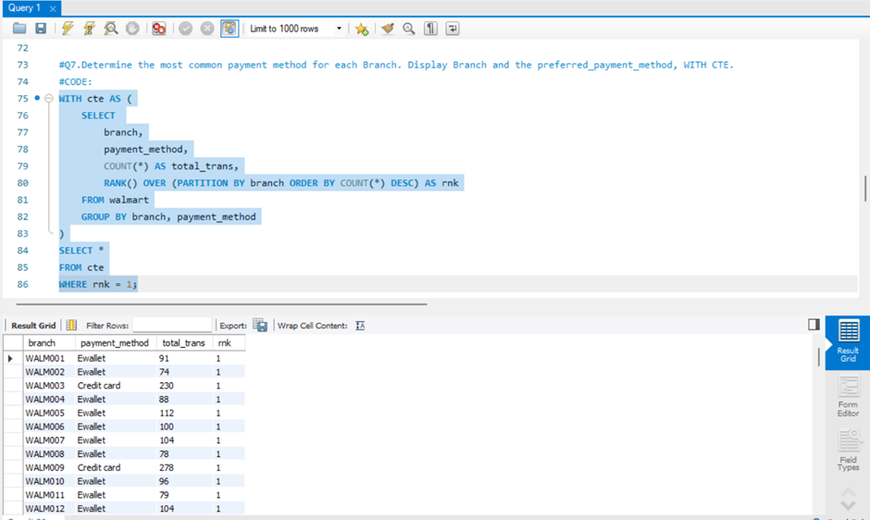
7. Determine the most common payment method for each Branch.
Display Branch and the preferred_payment_method.
Page 10
Next Slide

Slide 11
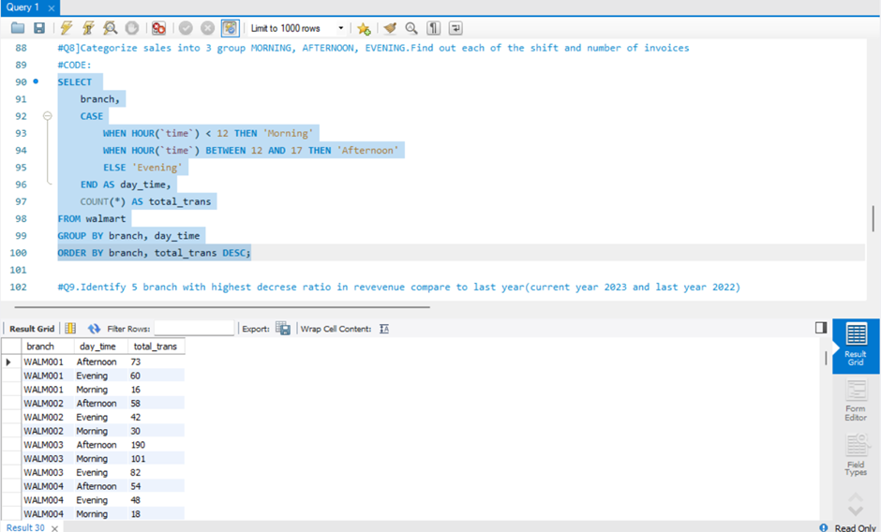
8. Categorize sales into 3 group MORNING, AFTERNOON, EVENING
Find out each of the shift and number of invoices
Page 11
Next Slide

Slide 12
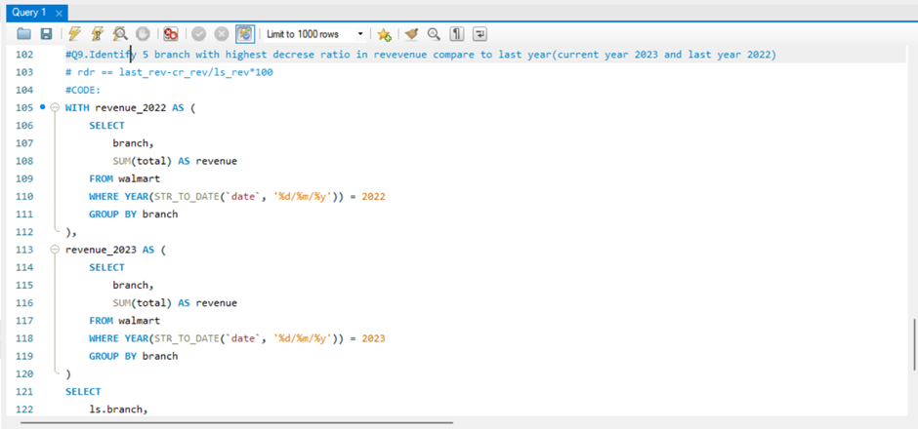
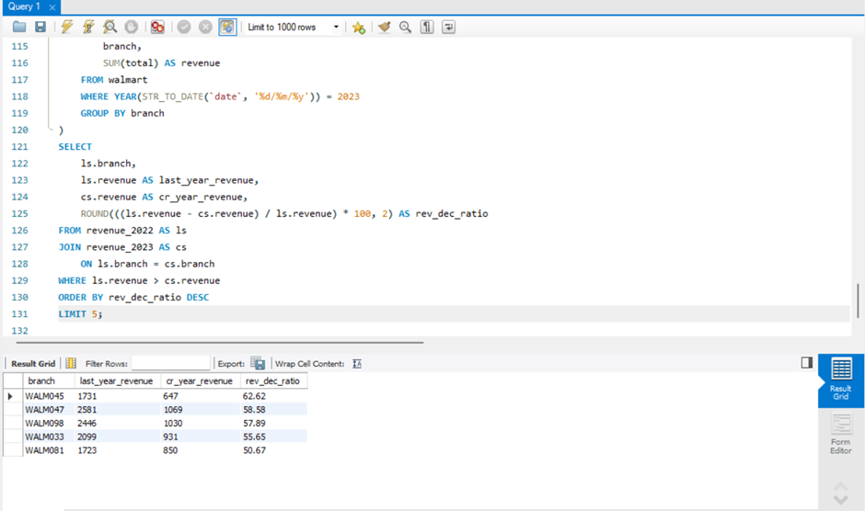
9. Identify 5 branch with highest decrese ratio in revevenue compare to last year(current year 2023 and last year 2022) rdr == last_rev-cr_rev/ls_rev*100
Page 12
Next Slide

Slide 13
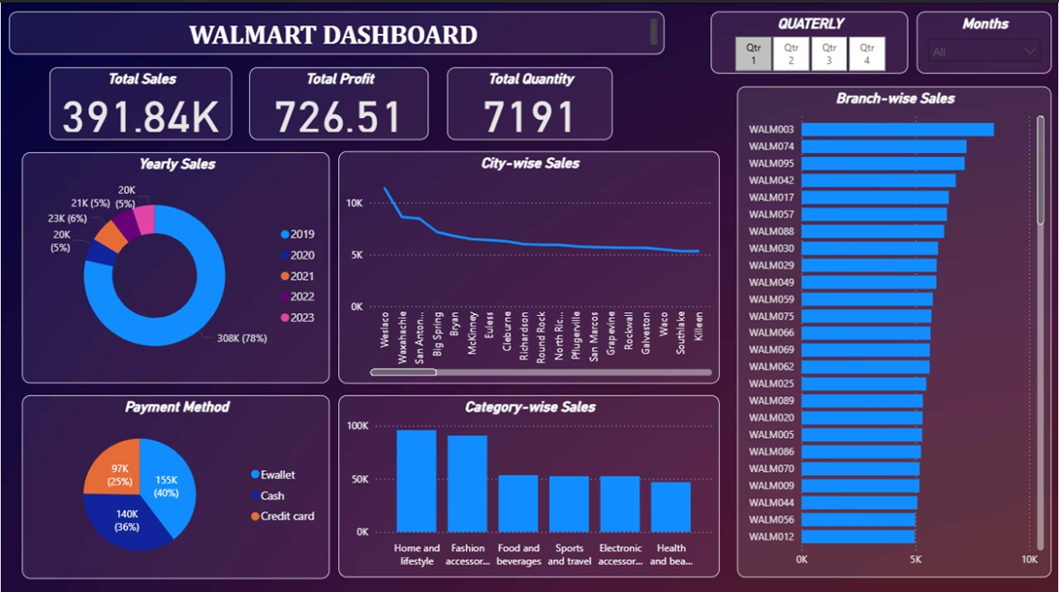
Dashboard using Power BI
Page 13
Next Slide

Slide 14
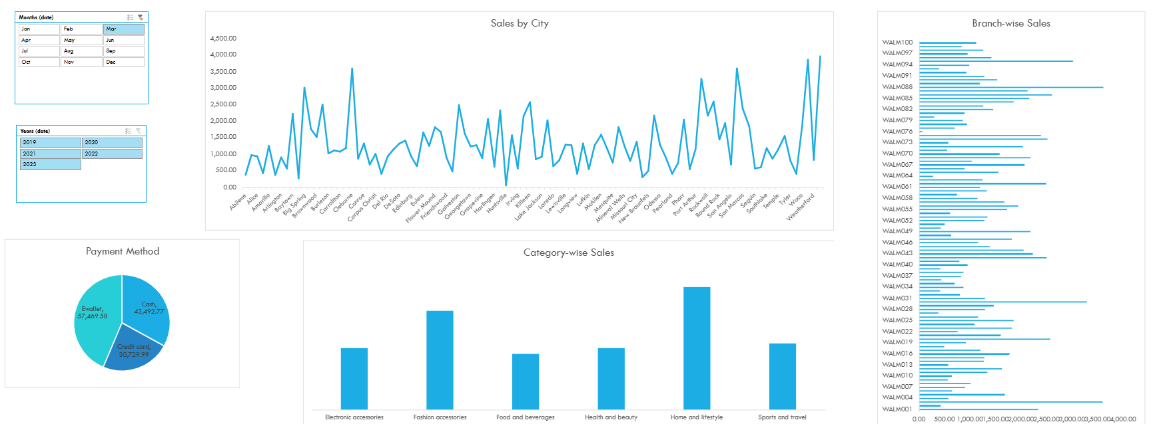
Dashboard using Excel
Page 13
Next Slide

Slide 15
Result
The Walmart Data Analysis Project successfully transformed raw sales data into a strategic business asset through a complete, end-to-end data pipeline.
Analysis revealed that Branch A generated the highest revenue, while Electronics stood out as the top-performing product category.
Customer segmentation uncovered distinct purchasing patterns, supporting more focused and effective marketing campaigns.
Temporal analysis highlighted Saturday afternoons (2–4 PM) as the peak sales period, providing valuable input for optimizing staff schedules.
The system processed the entire dataset efficiently across MySQL and PostgreSQL, achieving 95% data quality resolution.
A dynamic Power BI dashboard was created, including an executive summary, time-series sales charts, product performance treemaps, customer segmentation visuals, and geographical performance maps.
In addition, automated Excel reports using Power Query enabled detailed transaction-level insights for operational teams.
The project delivered measurable business value—improving inventory planning, enhancing targeted promotions, and guiding strategic branch decisions through a unified, data-driven decision framework.
Page 14
Next Slide

Slide 16


Conclusion
This project successfully demonstrates an end-to-end data pipeline transforming raw Walmart transactions into actionable business intelligence. By seamlessly integrating Python's processing power with SQL's analytical capabilities across MySQL and PostgreSQL, it overcomes common technology silos. The technical implementation features automated data acquisition, comprehensive cleaning, and retail-focused feature engineering.
The solution delivers concrete business value through interactive Power BI dashboards showcasing revenue trends, customer segmentation, and product performance. These were supplemented with automated Excel reports for operational analysis. Key achievements include identifying peak sales periods for staffing optimization, top-performing branches and categories for inventory management, and customer behavior patterns for targeted marketing.
The reproducible architecture, with its hybrid data model and validation framework, establishes a scalable foundation for data-driven decision-making across all retail functions, from executive strategy to operational planning.
Page 15
Next Slide

Slide 17
References
Kaggle (2023). Walmart Dataset. Retrieved from https://www.kaggle.com/datasets/najir0123/walmart-10k-sales-datasets
Provost, F., & Fawcett, T. (2013). Data Science for Business: What You Need to Know About Data Mining and Data-Analytic Thinking. O'Reilly Media.
McKinney, W. (2012017). Python for Data Analysis: Data Wrangling with Pandas, NumPy, and IPython. O'Reilly Media.
Date, C. J. (2019). An Introduction to Database Systems. Pearson Education.
Han, J., Kamber, M., & Pei, J. (2011). Data Mining: Concepts and Techniques. Morgan Kaufmann.
Sharma, A., & Kumar, S. (2020). Retail Analytics: Integrated Business Planning and Optimization. Palgrave Macmillan.
Leek, J. T., & Peng, R. D. (2015). What is the question? Science, 347(6228), 1314-1315.
Page 16
Next Slide

Slide 18
Thank
You!
Page 17
Next Slide

